Slide 1
LifeLabs Genetics Website Updates
Holiday Hours

Slide 2
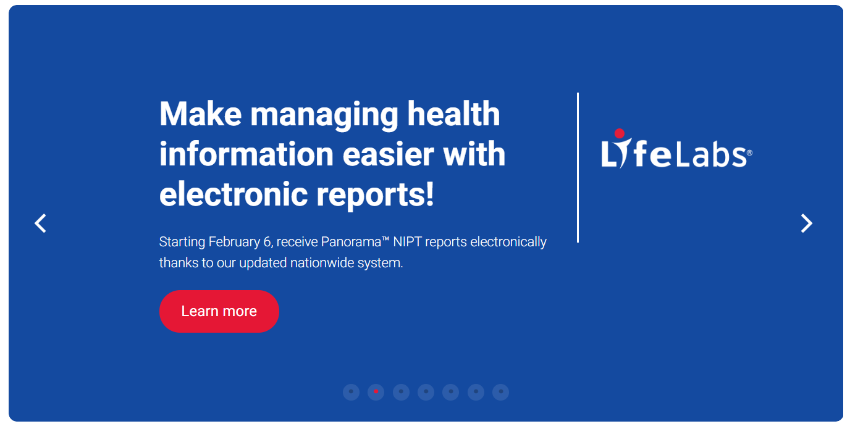
Change 1: Add a new banner to homepage carousel. It should appear on the rotation.
https://www.lifelabsgenetics.com/
1A. Image/layout like the Panorama e-reporting announcement but with the copy from 1B.
1B. Copy for banner
Holiday Season Turnaround Time for Panorama™ NIPT Results
For samples collected during the holiday period (Dec. 20 - Jan. 1) the reporting time may be slightly delayed, requiring up to 13 calendar days from when the sample reaches the lab.
There will be no Panorama™ Non-Invasive Prenatal Test (NIPT) collections on December 25, 26, and January 1.
1C. Link to new page
“Read More” button links to a new page (see next slide for new page copy/details)

Slide 3
Change 2: Create a new webpage under the News & Events section that the “Read More” button on the homepage links to
2B. Image to go in header image area on webpage (image file attached to e-mail).
2A. URL for this new webpage:
www.lifelabsgenetics.com/TAT-Results-Holidays
2C. Alt text for image:
Coniferous tress blurred with snowflakes falling
2D. Page Title: Turnaround Times for Panorama™ Test Results During the Holiday Season
2E. Page Copy:
IMPORTANT UPDATE FOR PATIENTS AND CLINICS
For samples collected during the holiday period (Dec. 20 - Jan. 1) the reporting time may be slightly delayed, requiring up to 13 calendar days from the time the sample reaches the lab. If you have any questions, please contact Ask.Genetics@LifeLabs.com or 1-844-363-4357.
There will be no Panorama™ Non-Invasive Prenatal Test (NIPT) collections on December 25, 26, and January 1.
The Genetics Helpline reached at 1-844-363-4357 (1-84-GENE-HELP) will have modified hours during the holiday period between December 24 and January 2. If customers have urgent inquiries, please email: Ask.Genetics@LifeLabs.com. This email address will be monitored regularly during the holiday season.
For hours of operation for LifeLabs collection centres over the holiday season, please visit http://locations.lifelabs.com.
Happy Holidays!
The LifeLabs Genetics Team
2F. Link to:
mailto:Ask.Genetics@LifeLabs.com
2G. Link to: http://locations.lifelabs.com

Slide 4
Change 3: on Panorama Non-Invasive Prenatal Test Page: https://www.lifelabsgenetics.com/product/non-invasive-prenatal-testing/
3A. Adjust the copy on the last bullet point to the text in the quotation marks:
“Panorama results are available within 7 – 10 days* of being received in the laboratory”
Below the last bullet point add the text:
*Closures during holidays may affect reporting times

Slide 5
Change 4: on Panorama Non-Invasive Prenatal Test Page: https://www.lifelabsgenetics.com/product/non-invasive-prenatal-testing/
4A. Add text below –
Sample collection will not be available on December 25, 26, and January 1. Closures during holidays may affect reporting times.

